Slide 1

UFC Bets
IST - 615 Cloud Computing Project Proposal
AI Powered Betting Website

Slide 2
UFC - The Sport : American Mixed Martial Arts
Combat Sport
5 rounds
2 fighters(Blue/Red)
Knockout, Decision, Submission
Number of punches, kicks, takedowns
Outcomes : Blue,Red,Draw,No Outcome
Barbaric and thus unpredictable
Has a huge betting population and is fast growing
io

Slide 3
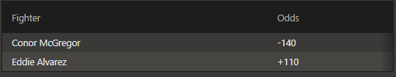
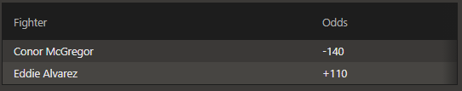
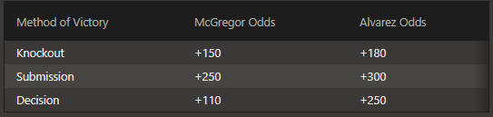
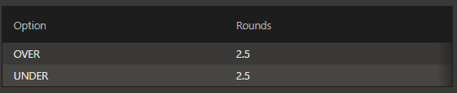
UFC Bets
Reading ODDS and Placing bets
Type of Bets
Moneyline, Method of victory, and total rounds.

Slide 4
Business Idea
In the current situation, where everything is moving online right from taking classes to ordering food. Why not bring betting system to online secure platform for one of the most action-packed sport on the planet "UFC fights".
Leverage the highly unpredictable nature of the sport
Algorithmic manipulation of the Odds using fight analytics
Knowledge of the winner of a brawl with the information of the fighters and their prior records.
Give ‘THE BEST’ available odds and wagers for the users
Better ODDS/Wager rates - More users - More profit
Minute on Minute updation of ODDS
Using AI Powered Marketing and User Behaviour Analytics to gain the edge over the competitors
Hosted on the Cloud to support ubiquitous and synchronous usage
Advertising and 3rd party funding
Low Entry prices - To attract low profile users
Invent, Strategize and Monopolize

Slide 5



Product Idea & Competitor Analysis
An online UFC dedicated betting website with fight statistics (fight tracking), articles and highlights (hosting) and fan blogs.
A one stop shop for UFC fans.
The fights being competitive yet sometimes predictable based on player stats and techniques, makes this sport a very good place to make money.
Competitors
MyBookie
Bovada Sports
SportsBetting.ag
BetOnline Sports
Xbet
Mentioned competitors have rollover requirement which our company is relaxing for the user
These website hosts multiple sports for online betting, what make us different is exclusivity to UFC sport

Slide 6
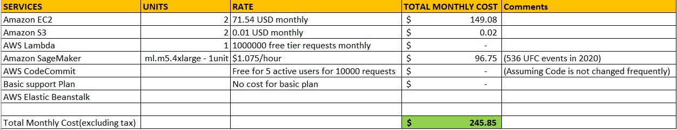
COST MODEL
Infrastructure setup: $245.85*12 = $2950.2 (Click on the cost to view AWS estimates)
License Cost: Upto $75,000/year
Marketing Cost: Initially social media platforms will be used
Integrating multiple payment options: To be decided
Customer Service: As per requirement

Slide 7
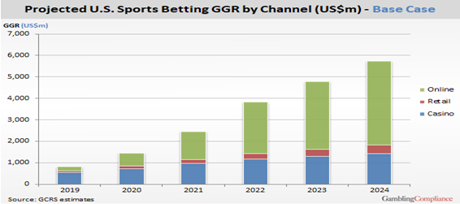
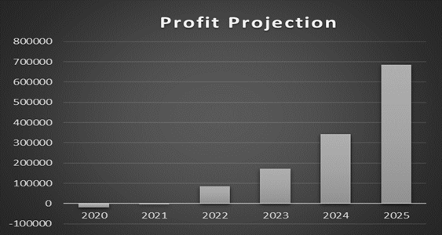
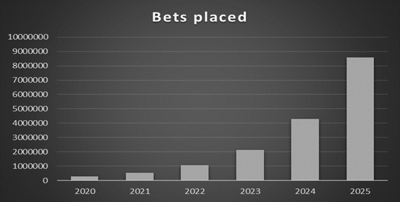
Revenue Model : Freemium
Users :
Free Users
Premium Users
Revenue Streams :
Bets by customers
Margins : Odds Algorithmic Tweaking
Customer Engagement : User Behavior Analytics
Revenue from premium account subscriptions.
Revenue through ads on the website and fan blogs (other media content)

Slide 8
Scope of the Project
Hosting the Data Base on the Cloud
Building the Machine Learning Model on the Cloud
Fight By Fight automated predictions
Fight analytics dashboard to engage users
Setting the optimal odds using the predictions
Update the Database with the outcome of the fight for future use (Improves Model)
Initial Objective : Moneyline Bets
Future Scope
Expand the functionality for round bets and method of victory bets
Scale the application container using kubernetes with respect to predicted user volume

Slide 9
Proposed Implementation Architecture
Amazon S3 to hold the enhanced, and transformed data.
Data transformation code hosted using AWS Lambda to prepare the raw data for consumption and ML model training, and to transform data input and output(We might do this locally)
A staging bucket for the feature engineered and transformed data that will be ingested into Amazon SageMaker
SageMaker to build and train machine learning models, and then directly deploy them into a production-ready S3 endpoint
Amazon API Gateway endpoints to host APIs to post the predictions to be used on the betting website
Feed the predictions into the ODDS generation algorithm
Dockerize the web application

Slide 10
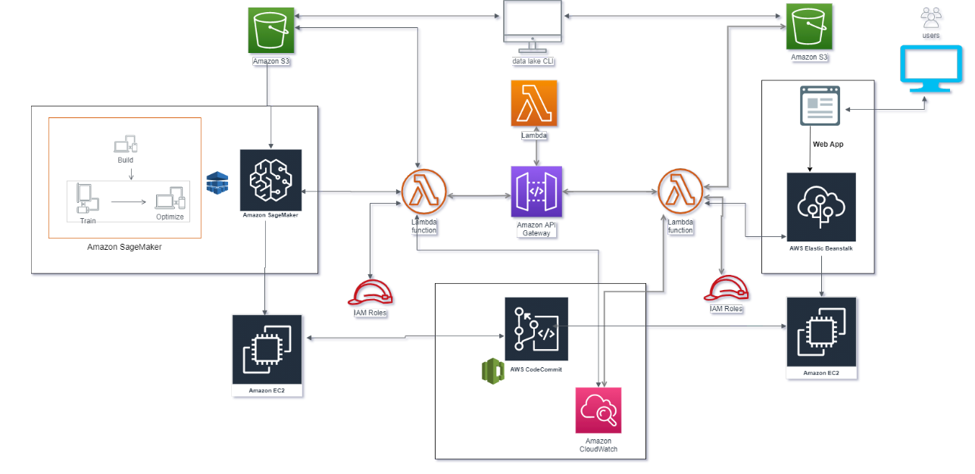
High Level Architecture Diagram in AWS

Slide 11
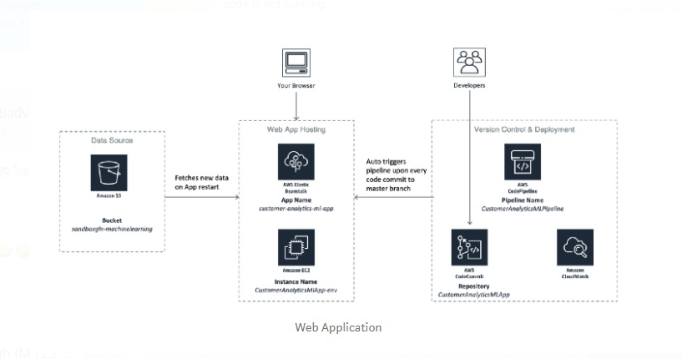
Proposed Devops Workflow

Slide 12
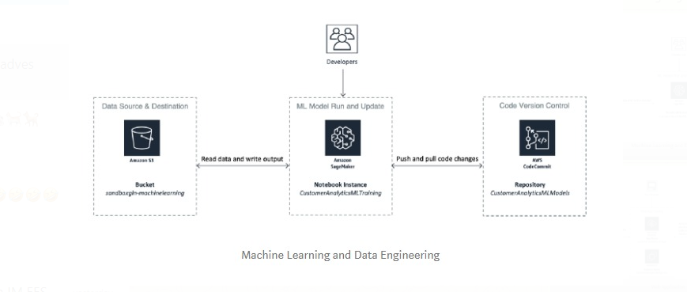
Proposed MLops Workflow

Slide 13
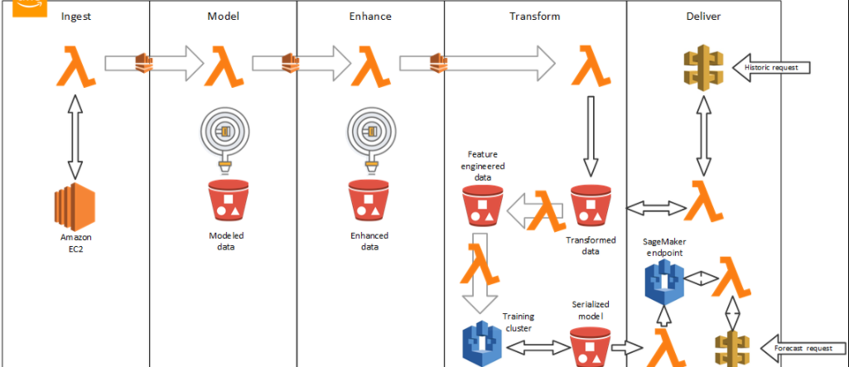
Future Scope to Enhance Prediction Using Iterative Cognition

Slide 14
Goals and expectations for the final presentation
Understand,Assimilate and Engineer the Data (Completed)
Build Classification models to predict the outcome locally(In progress)
Next Steps:
Host the data and engineering techniques on the cloud
Choose the best model for predictive analytics
Create the ODDS generation algorithm
Host the predictive model on the cloud and get live predictions
Feed the predictive outputs to the ODDS generation algorithm
Create the front-end UI, dockerize and make it available for live demo

Slide 15
Seeking 150000$ investment for 21% Equity stake, if we form a company

